Slide 1

Red Wine Quality Predictors by The Three Musketeers

Slide 2
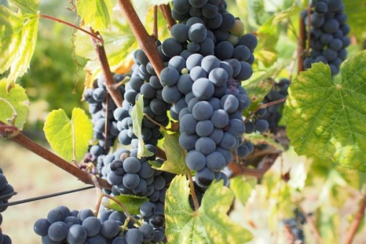
Introducing

Slide 3


Autumn Heyman
Education:
BS Alternative Medicine (Everglades University)
MPH Complementary & Alternative Medicine, Functional Nutrition (Everglades University)
MBA Non-Profit Leadership & Management (Liberty University) (currently pursuing)
Current Profession:
Sole-proprietor facilitating respite, in-home, and community service supports for adults with developmental/intellectual disabilities
Data Science Pursuits:
Field research, analyzation, and program development to address turnover, retention, and employment attraction to the field.
Tools to convert field documentation into actionable agency policies to provide more customed, tailored delivery of individual supports.
Public policy development and reform.
Favorite Languages: R and Python
Favorite Wine: Malbec

Slide 4
Erin WeaveR, CSW
Education:
BA International Languages & Cultures
AA International Business
AS Accounting
Certified Specialist of Wine
Current Profession:
Staff Accountant
Data Science Pursuits:
Favorite Language: R & SQL
Favorite Wines: Mourvedre & Carmenere

Slide 5
Georgia Miller
Army National Guard veteran with a background in GIS
Education:
Responsive Web Design Certificate (FreeCodeCamp)
Google Data Analytics Certificate (Coursera)
BS Accounting Western Governors (University)
Current Profession:
Operations Administrator for premier auto hauler
Data Science Pursuits:
Research analytics, field modeling
Favorite Language: R / Python
Favorite wine: Merlot

Slide 6
BACKGROUND

Slide 7


“What's in a wine? A wine by any other grape would taste as sweet.”

Slide 8
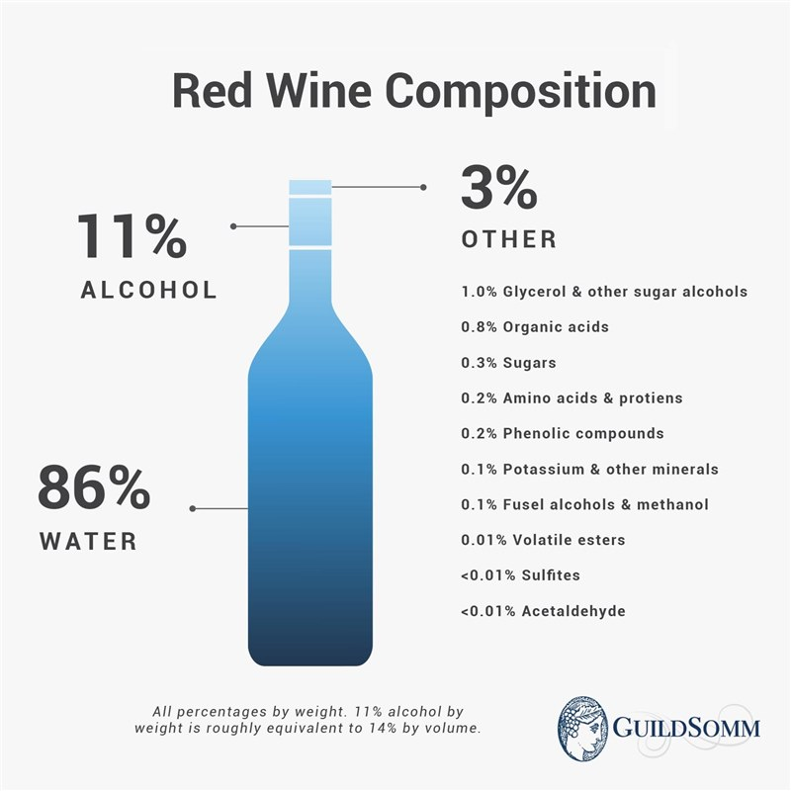
What’s in a wine? - Composition
In general, the average concentrations of the major components of wine are
water, 86%
ethanol, 12%
glycerol and polysaccharides or other trace elements, 1%
different types of acids, 0.5%
volatile compounds, 0.5%

Slide 9
“Is it a great wine, or a not so great wine? That is the question.”

Slide 10
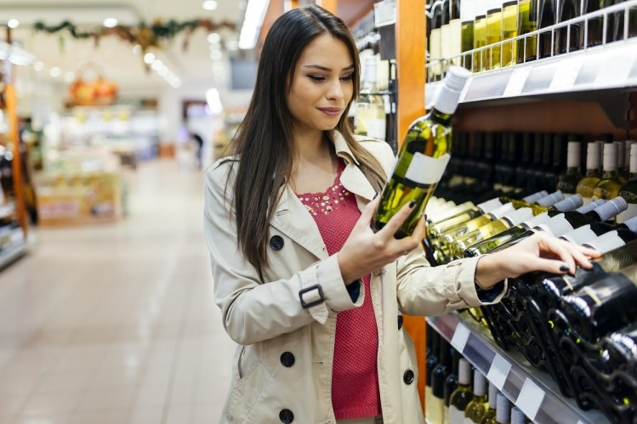
Consumer
Personal Preference
Rating
Value (Price)
Packaging
Very Subjective

Slide 11
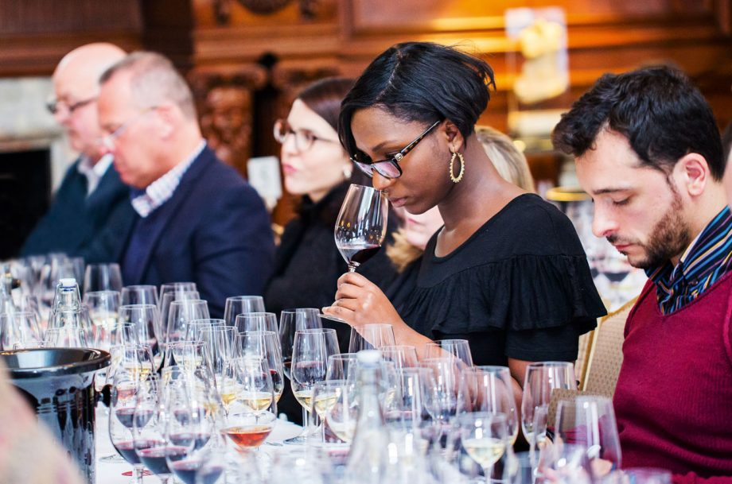
INdustry ProfessionalS
Trained to evaluate wine in a systematic way
ex: WSET tasting guides

Slide 12
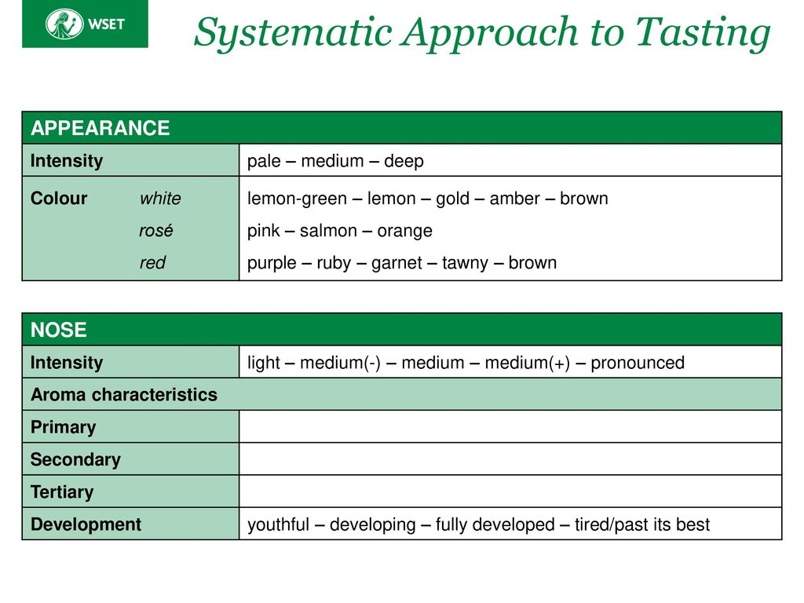

Slide 13
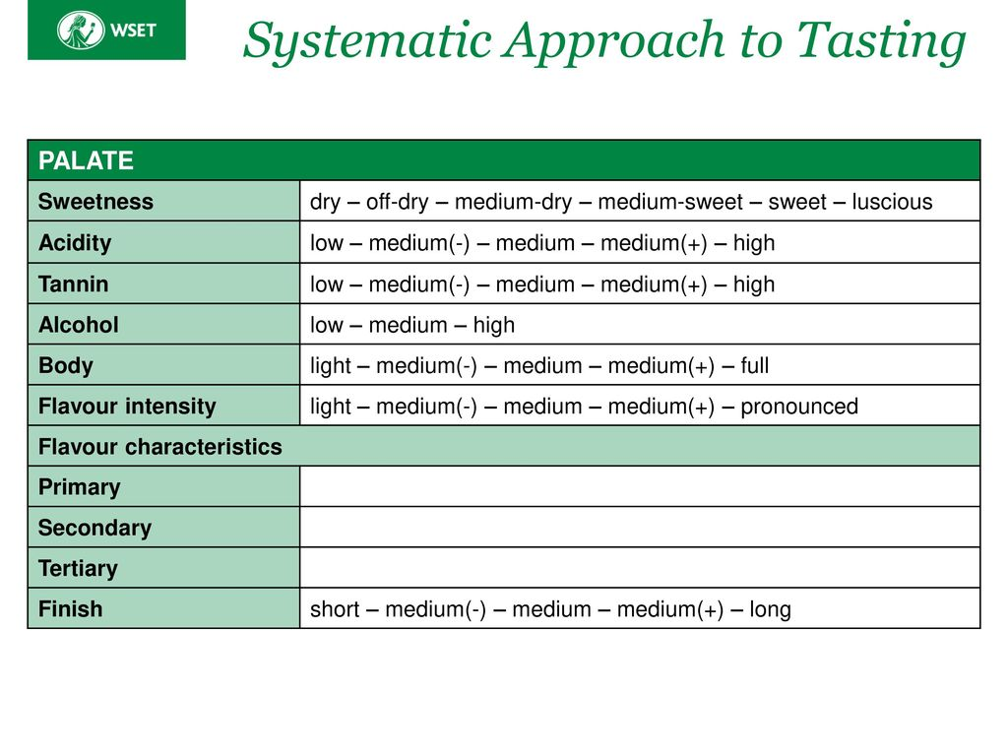

Slide 14
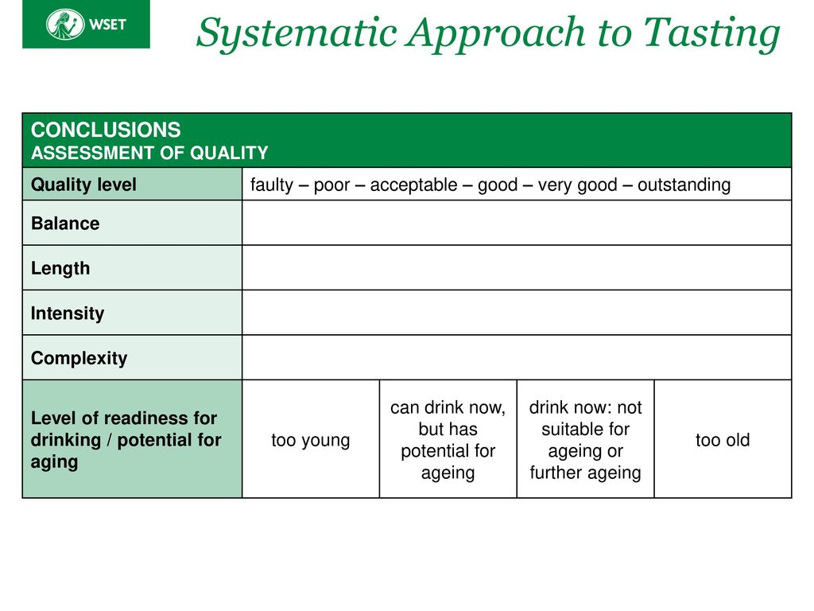

Slide 15
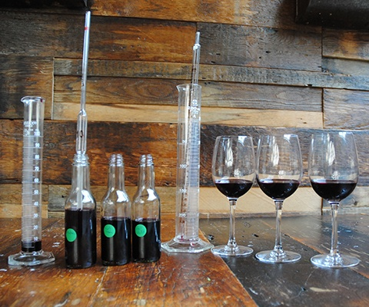
Wine Quality – Producer
Terroir, Climate, Weather
Grape Ripeness
Winemakers have numerous techniques available to them to correct for flaws or adjust the final profile of the wine.

Slide 16
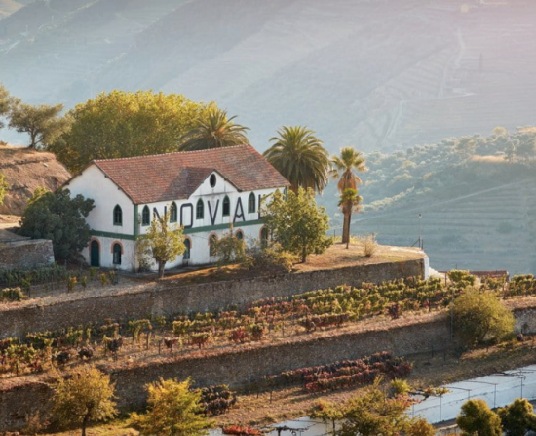
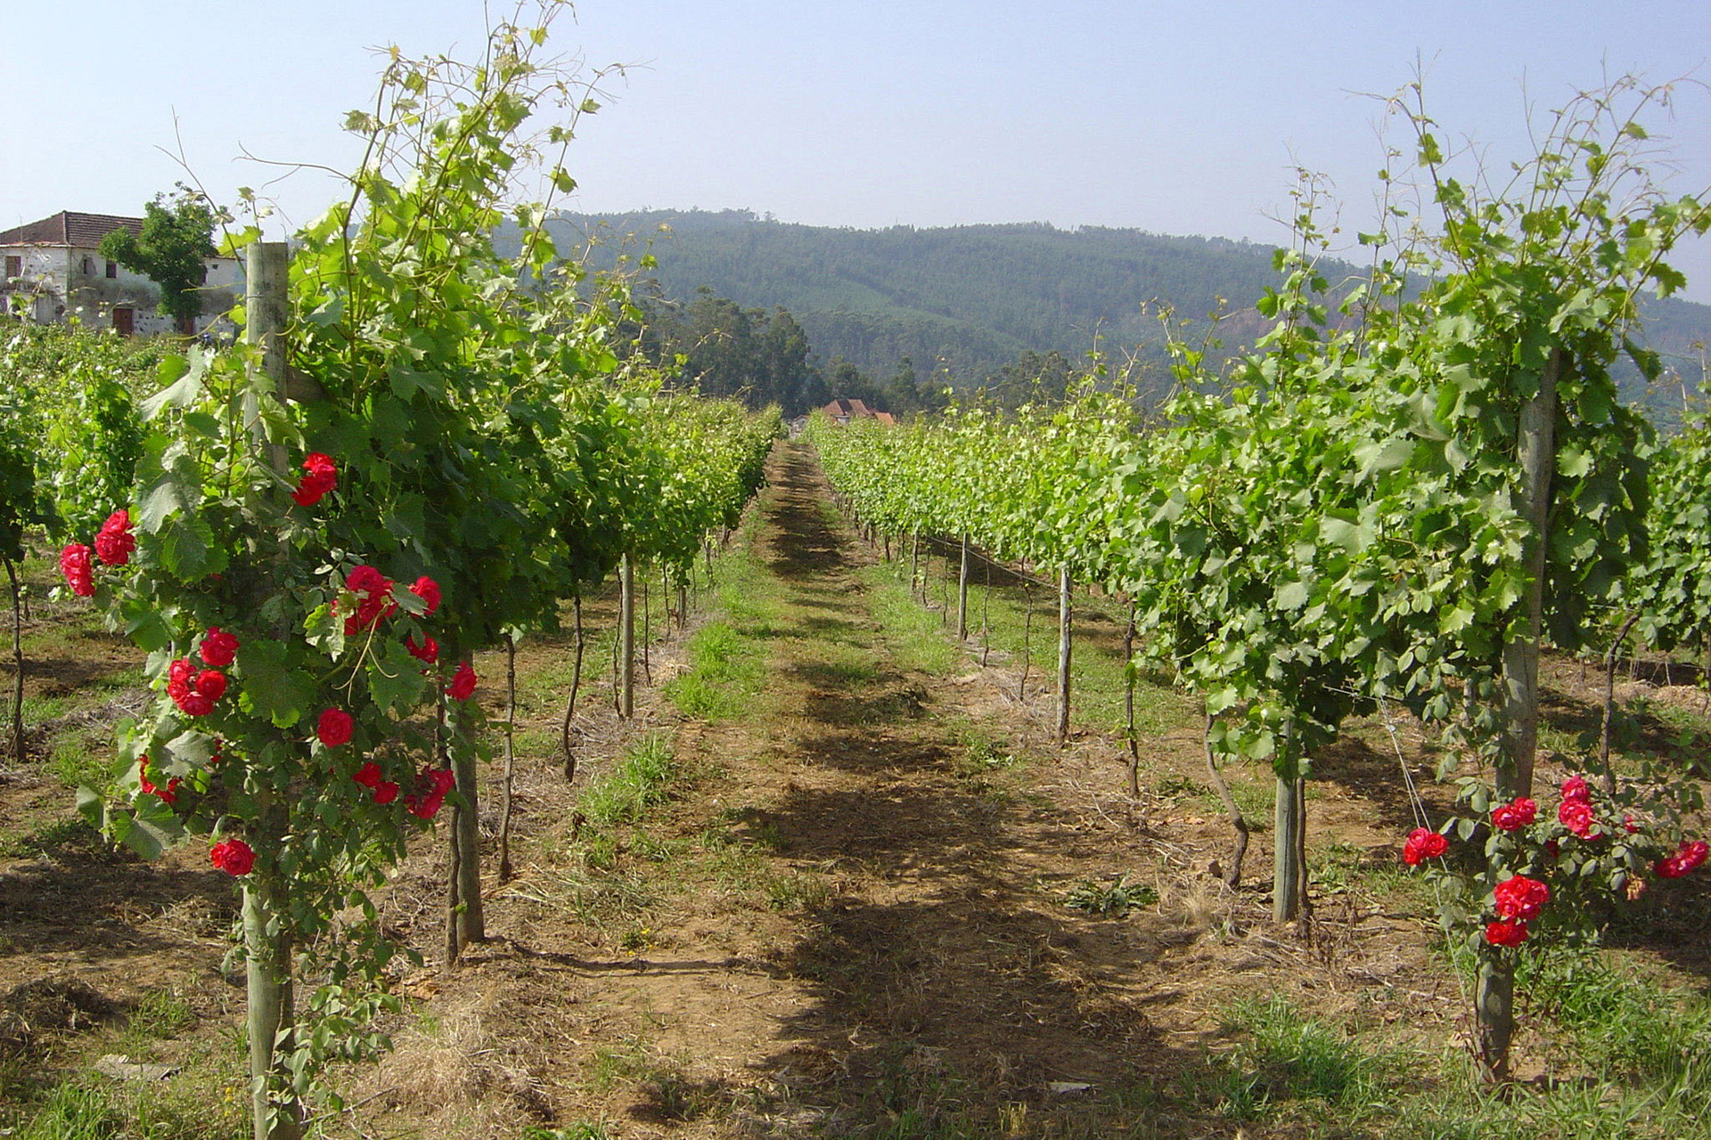
PURPOSE :
There is an opportunity for producers to capitalize on the insights gleaned from the following data analysis.
Make better choices during vinification
Improve wine quality
Receive higher ratings
Increased sales and distribution
Expand regional awareness through wine

Slide 17
ProjecT Background: Portuguese wine Production & Exports
Portugal: 5th largest wine producer in Europe, 11th largest in the world
2020: Despite COVID-19 pandemic: Portuguese wine exports ⬆️5% compared to 2019.
306 million liters of wine exported, valued at $936 million
2021: Portuguese wines grew 3.8% (volume), 8.6% (value), 4.6% (average price) from 2020.
Ministry of Agriculture: has honed its focus on monitoring farmers and wine producers.
Why? The increasing value of Portuguese wine, currently in competition with France, the United States, the United Kingdom, Brazil, and Germany
Action Plan: Define & implement measures to guarantee predictability/stability in Portuguese wine production.
Wine certification and quality assessment are key elements within this context.

Slide 18
The DATASET

Slide 19
The DataSet
2009 Study led by Paulo Cortez at the University of Minho in Guimarães
1599 wrangled down (for NAs) to 1143 red wines from Minho were analyzed for 11 chemical properties
Fixed Acidity, Volatile Acidity, Citric Acid, pH
Total Sulfur Dioxide, Free Sulfur Dioxide, Sulphates
Residual Sugar, Chlorides, Density, Alcohol
Ranked for Quality on an 11 point scale

Slide 20
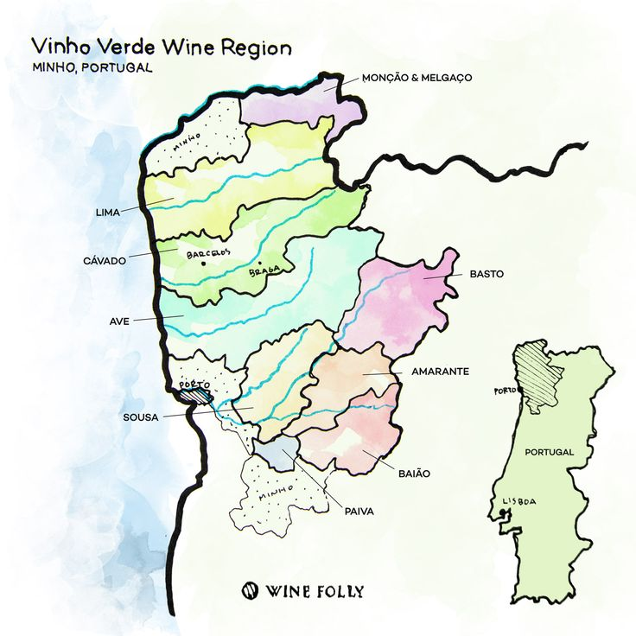
Wine region
North West corner of Portugal
Cool, rainy climate makes it difficult for red varietals to ripen
Vinho Verde is particularly known for its bright, summery white wines with subtle carbonation.
Red and rosé Vinho Verde wines are the region's ‘rare gems’.

Slide 21
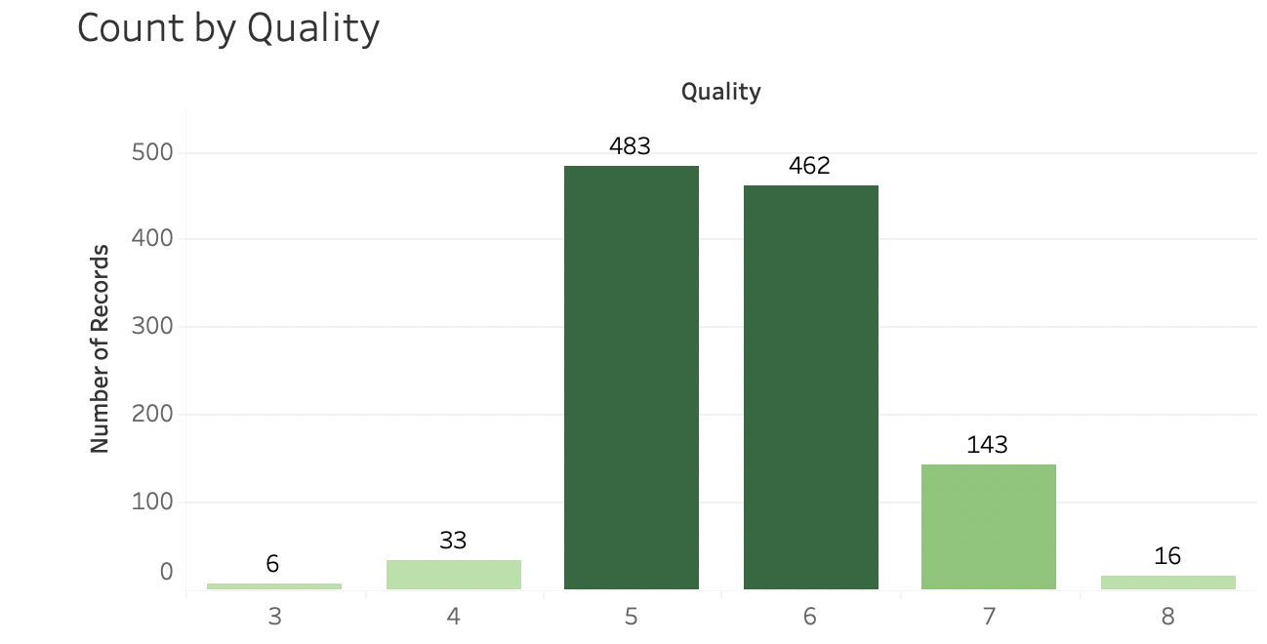
The DataSet
Skewed towards the middle
83% of records classified as either a 5 or 6 in quality

Slide 22
Evaluation Questions
Which physiochemical properties of wine have the greatest impact on wine quality?
How do these properties individually impact quality?
What balance or interplay between these properties contribute to necessary for the best quality wine?

Slide 23
Methodology

Slide 24
Original METHOD
First Analysis: Which physiochemical properties of wine have the greatest impact on wine quality?
Stepwise Binary Logistic Regression
Second Analysis: How do those properties individually impact quality?
KMeans
Recoded quality into two groups
good
poor
Results inconclusive – many outliers and no real significant properties

Slide 25
METHOD – Assessing Impact
First Analysis: Which physiochemical properties of wine have the greatest impact on wine quality?
Ordinal Logistic Regression
Googled OLR steps, received mixed results for set up, melded methods together based on needs
Recoded quality 5,6,7-8 and 3-4,5-6,7-8 to see the difference in distribution
Decided to go with 3-4,5-6,7-8 due to more even distribution

Slide 26
METHOD – Assessing Relationship
Second Analysis: What balance or interplay between those properties is necessary for the best quality wine?
Linear Discriminant Analysis
Wanted to see ratio of the selected properties compared to quality to determine level of quality
Ran LDA with outliers and without outliers to compare accuracy

Slide 27
RESULTS

Slide 28
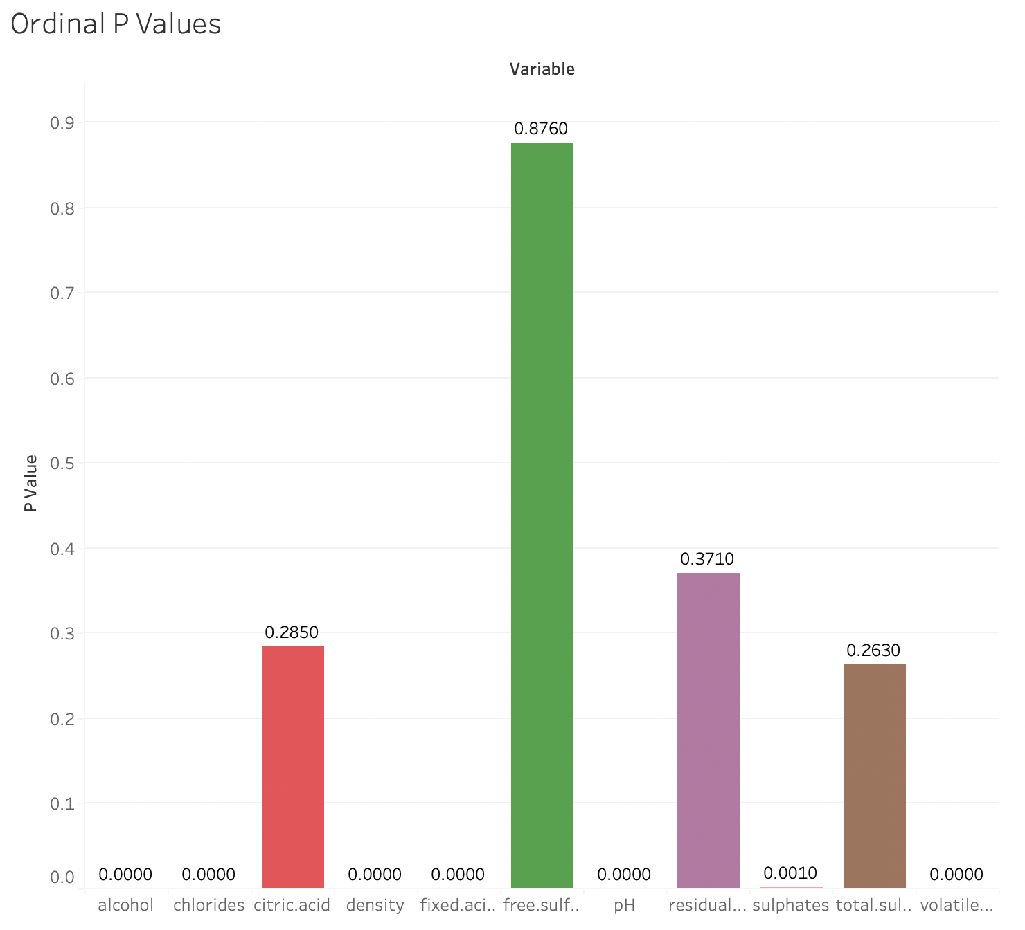
Results – Impact Analysis

Slide 29
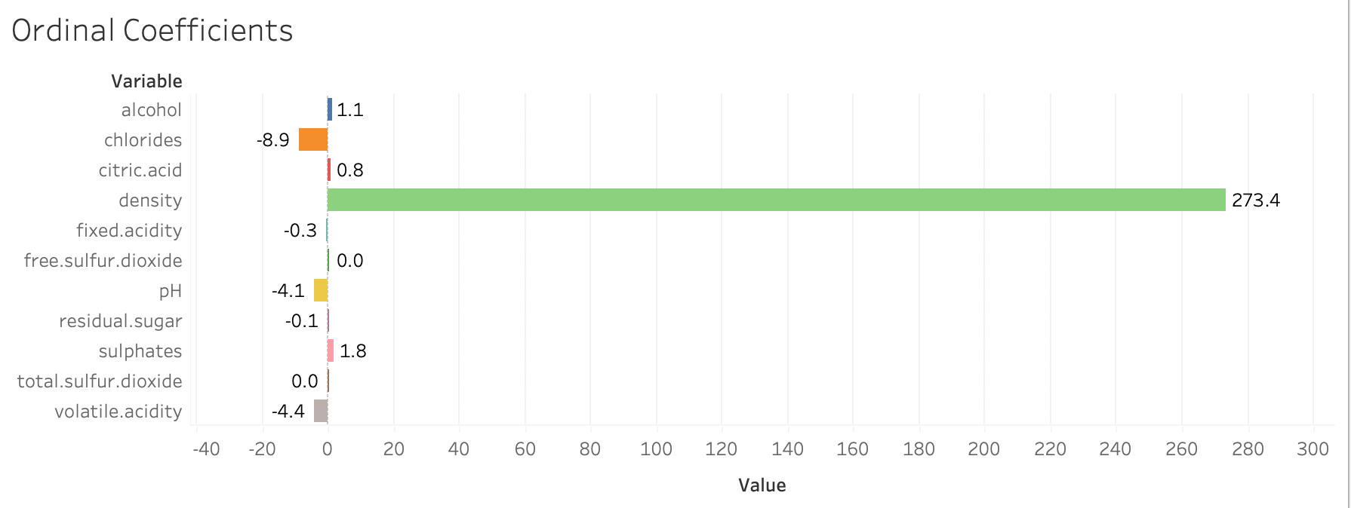
Results – Impact Analysis

Slide 30
Results – Relationship Analysis

Slide 31
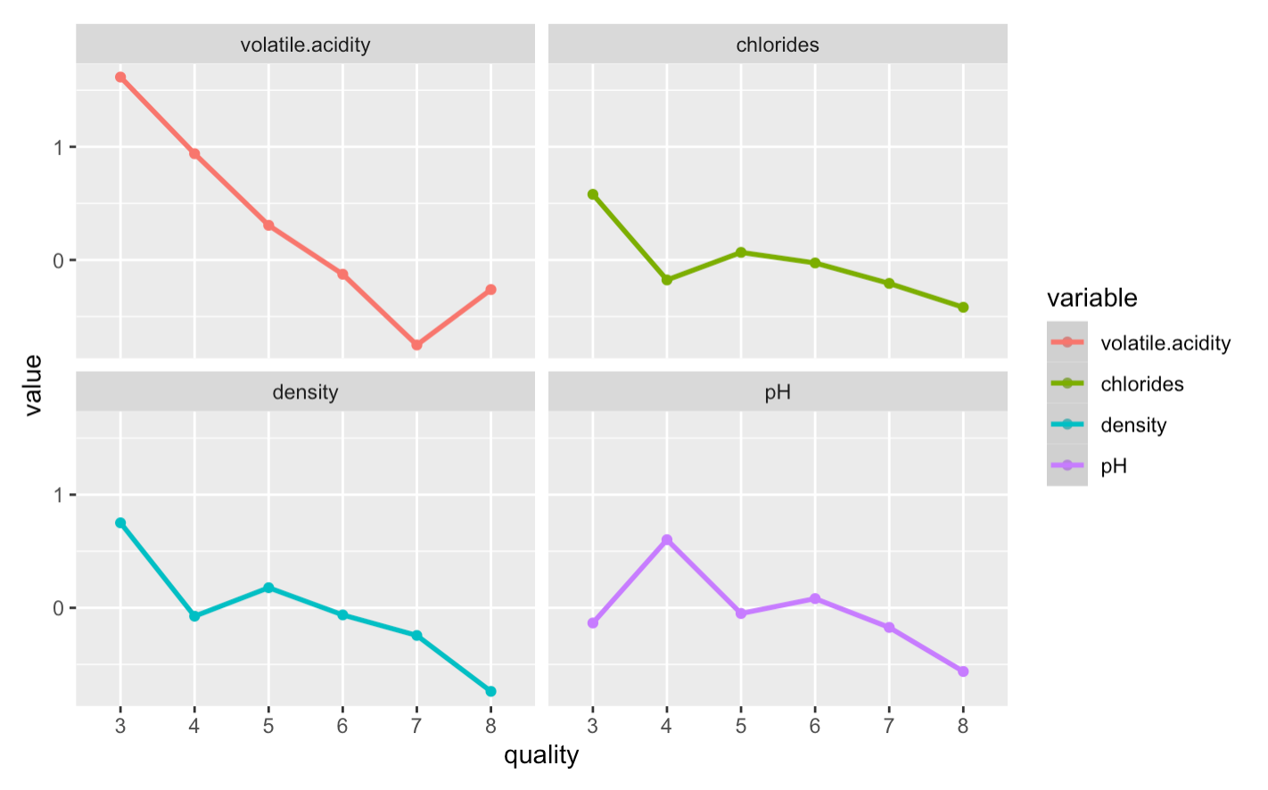

Slide 32
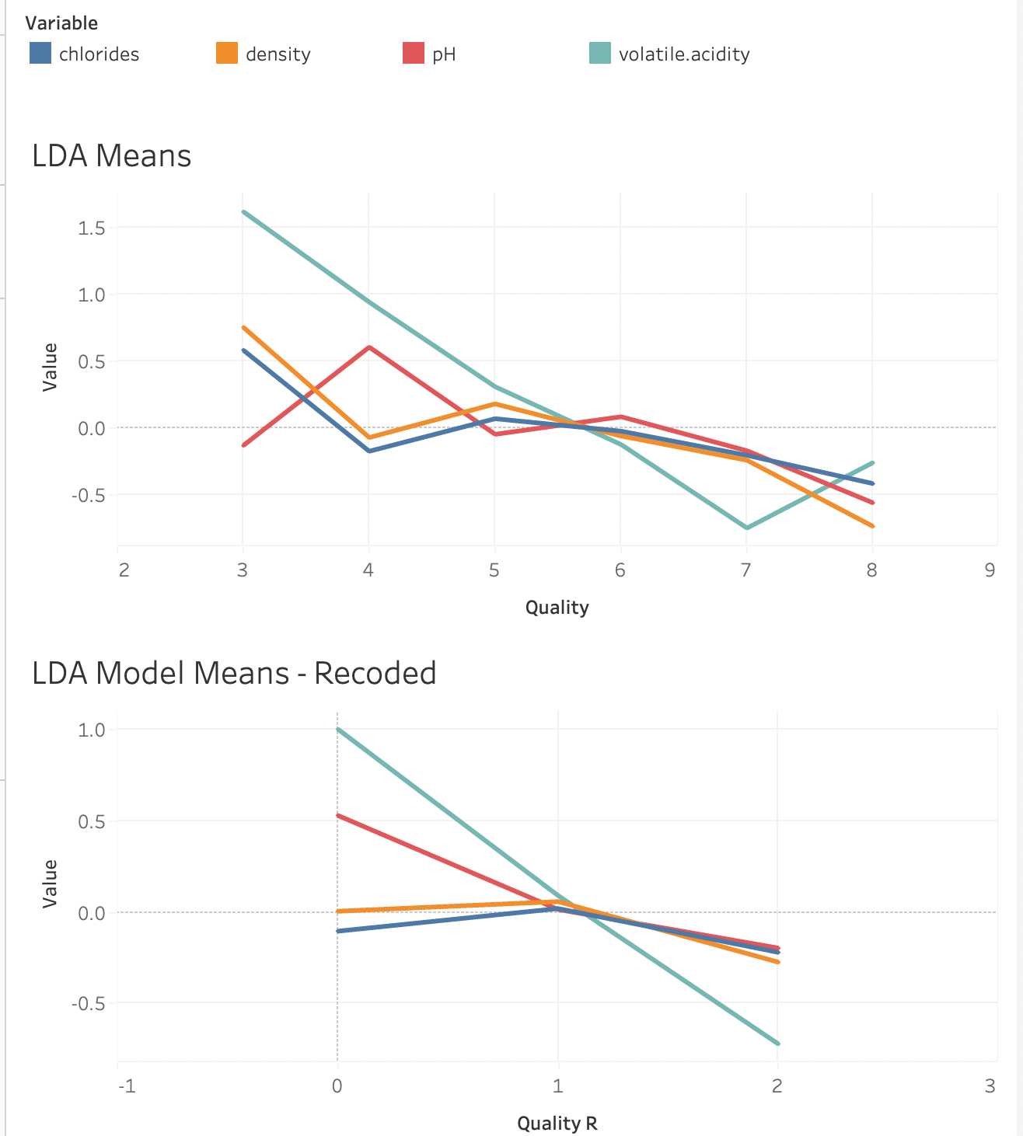

Slide 33
Results – Relationship Analysis
Discussion about variance between the means ratio for each quality level

Slide 34
SUMMARY & CONCLUSIONS

Slide 35
Summary
Our analysis indicates that of the 11 measured properties of wine, 7 had a significant impact on quality score.
Top 4 Variables
Analyzed how they individually and collectively impacted quality

Slide 36
Conclusions
Wine quality is both subjective & objective
Quality is not determined by one property, but by several
Quality is affected by the ratio between those properties
There are other variables that could be affecting our data & results

Slide 37
QUESTIONS ?

Slide 38



